Slide 1

Data Analytics Project Adventure works cycles

Slide 2





agenda
Introduction
Data Overview
Objectives: KPIs
Analysis
Recommendation And Insight Conclusion

Slide 3
Introduction
Welcome to the Adventure Work Cycles Data Analytics Project, where we analyze key performance metrics to enhance business operations, customer satisfaction, and overall performance.
This study leverages the Adventure Work Cycles Dataset, providing critical insights into sales trends, customer preferences, product performance, and regional market dynamics.
The dataset provides insights into product types, including bikes and accessories, regional sales performance across key markets, customer purchasing patterns and preferences, revenue metrics such as sales figures and profit margins, and inventory status with a focus on stock levels and supply chain efficiency.

Slide 4
Data overview
Adventure Works cycles is a Fictional multinational manufacturing company that sells bicycles and cycling-related products. To align the dataset’s attribute with an Adventure Works cycle theme, here’s how we can modify and redefine
the features:
Product Name: Name of the cycling product (e.g., Mountain Bike, Road Bike, Helmet, Accessories).
Store/Location: Physical or online store location where the product is available (e.g., Germany, Australia, US).
Category: The product category (e.g., Bikes, Accessories, Clothing, Components).
Average Price: The average price of the product, giving insights into pricing strategies.
Customer Rating: A weighted average rating based on customer reviews for the product.
Customer Votes: The number of customer votes for the product, indicating popularity or customer satisfaction.
Reviews: Customer reviews and feedback on the product or service experience.
Online Purchase Availability: Indicates whether the product is available for online purchase.
In-Store Pickup Availability: Indicates whether customers can reserve and pick up the product in-store.
Product Type: Categories such as Mountain Bikes, Road Bikes, Hybrid Bikes, or other product types like Helmets and Clothing.
Country: The country where the product is sold or the store is located.

Slide 5
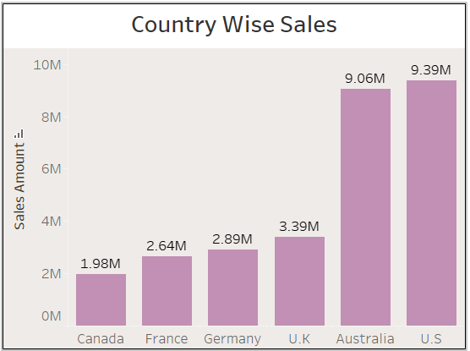
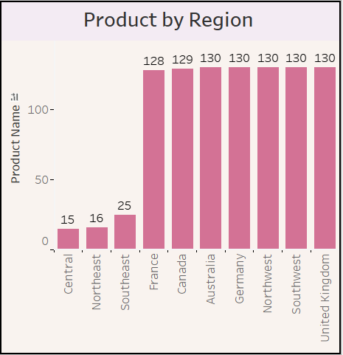

Analyzing sales and Product
The Company’s largest presence is in almost more than 2 regions that are Australia, Germany, US’s Southwest and Northwest area and UK. The U.S made the largest sale. Whereas Australia and U.K had the potential for growth.
Key Insight
Top Sales Regions: U.S. leads with 9.39M, followed by Australia with 9.06M.Growth Potential: U.K. (3.39M) and Australia show potential for further growth.
Low Sales Regions: Canada (1.98M), France (2.64M), and Germany (2.89M) need improvement.
Product Diversity: Most regions offer 130 products, while Southeast (25), Northeast (16), and Central (15) lag significantly.
Focus Areas: Expand product range in underperforming regions and explore growth in U.K. and Australia.

Slide 6
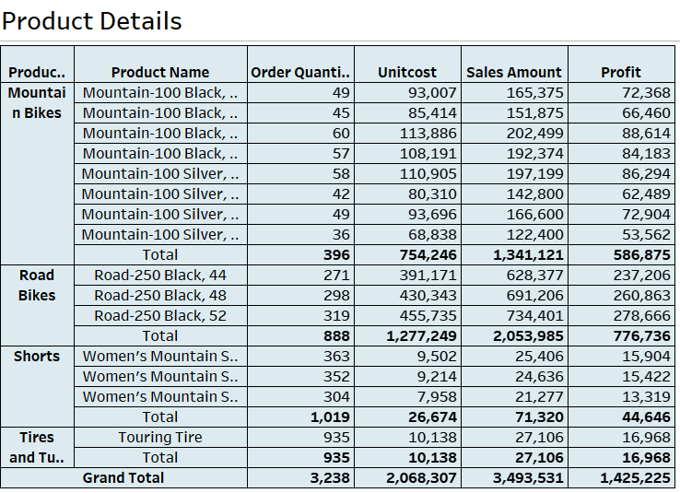
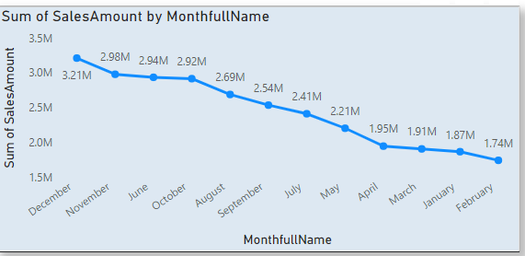


Product and sales analysis
The table provides detailed data on various product categories (Mountain Bikes, Road Bikes, Shorts, and Tires).
The line chart displays the Sum of Sales Amount across different months (January to December).The trend shows a decline in sales over the year.
Key Insights
‘
Mountain Bikes contribute the highest revenue and profit.
Tires have the lowest contribution in terms of sales and profit.
Some products have significantly higher sales volumes, leading to notable profitability differences.
Highest sales amount is observed in the earlier months (December, November).
A steady decline is visible, with the lowest sales amount occurring in the later months (October, September, etc.).
This trend could indicate seasonality or declining demand over the year.

Slide 7
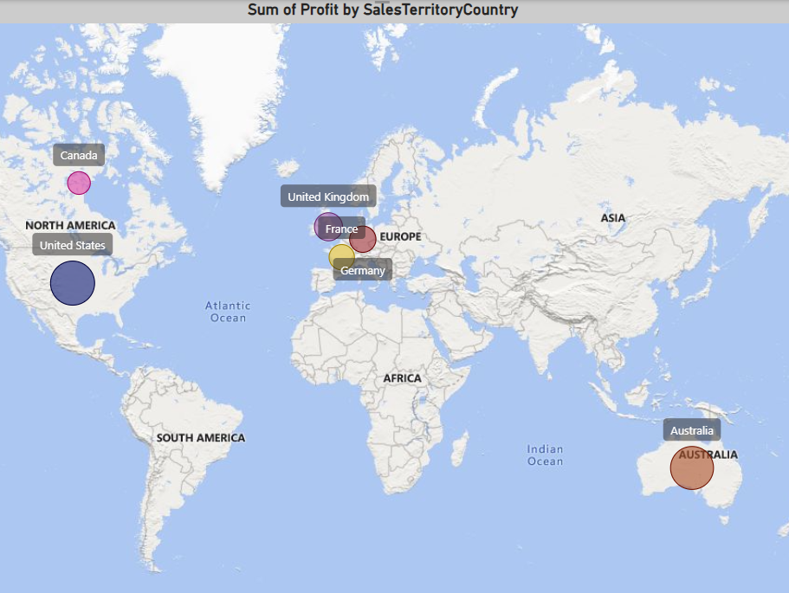
Analyzing Profit
Key Insight
The US drives the majority of profits, but other regions like Canada present opportunities for growth.
Profits are distributed across key regions:
United States: 3.05M, the highest contributor.
Canada: 0.5M, showing modest performance.
Other regions reflect mixed results, suggesting potential untapped markets.
The map highlights profit distribution across regions, with the United States contributing 3.05M, the highest among all countries, and Canada generating 0.5M. Other regions show variable performance.

Slide 8
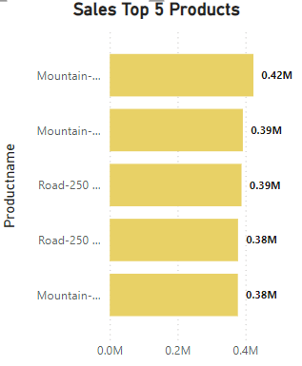
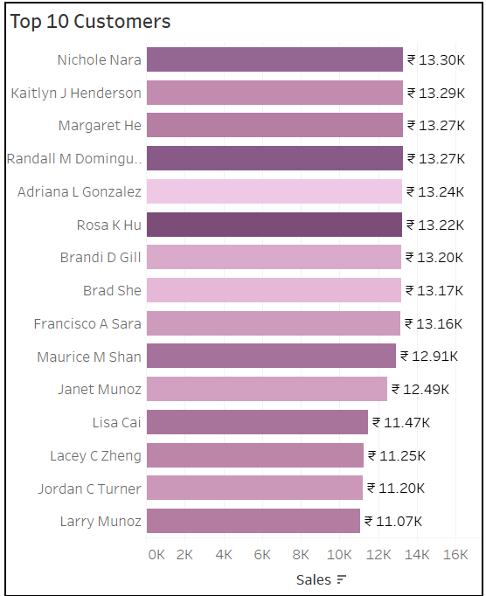
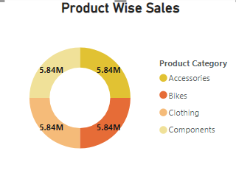
Analyzing Customers
Sales of Top 5 Products: This horizontal bar chart shows the sales performance of the top 5 products, with "Mountain-200" leading at 0.42M and "Mountain-300," achieve slightly lower but comparable sales, all around 0.38M.
Top 10 Customers: The horizontal bar chart ranks the top 10 customers by their purchase amounts, with all ten contributing sales ranging from ₹13.0K to ₹13.4K.
Product-Wise Sales: This chart highlights sales distribution across different product categories: Accessories, Bikes, Clothing, and Components, all generating approximately ₹5.84M each.
Key Insight:
"Mountain-200" is the best-selling product, but the sales figures among the top products are relatively close, indicating a balanced demand.
Customer contributions are evenly distributed among the top 10, emphasizing the importance of maintaining strong relationships with all customers.
Sales are evenly distributed across categories, suggesting consistent demand across the product portfolio.

Slide 9
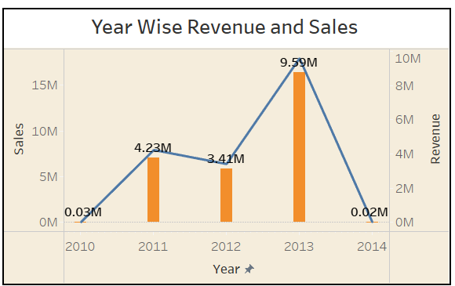
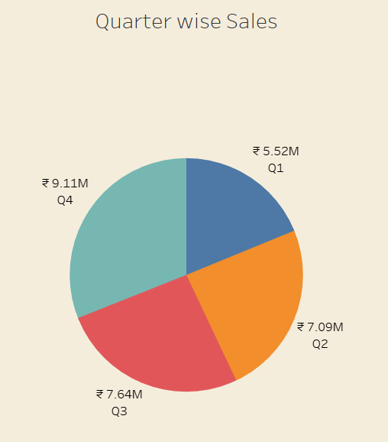
Revenue and Sales Trends and Quarterly Sales Analysis
Quarter-Wise Sales: The pie chart shows sales distribution across four quarters, with Q4 achieving ₹9.1M, the highest sales, while Q1 lags behind at ₹5.52M.
Key Insight:
Sales peak in Q4, indicating a seasonal boost, while Q1 requires strategies to improve performance.
Year-Wise Revenue and Sales: The bar and line chart illustrates revenue and sales trends from 2010 to 2014. Revenue peaked at $9.9M in 2012, coinciding with the highest sales figures. However, both revenue and sales dropped significantly in 2014.
Key Insight:
2012 was the most profitable year, but the decline in 2014 signals a need to investigate and address potential challenges.

Slide 10
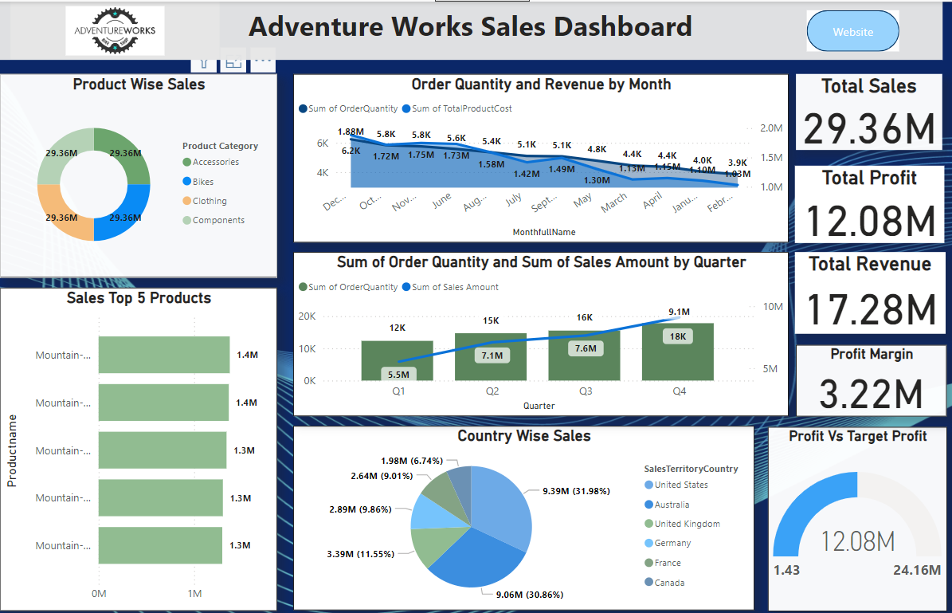

Slide 11
Thank you
Saumya Chitranshi

